Slide 1
Hypersequents, constraints, and a bunch of doodles Wen Kokke

Slide 2
Previously, on ABCD...

Slide 7
nope.

Slide 8
Specifically: we add x∉G as
a side-condition to every logical rule!

Slide 9
Yes, it does! Good job, past-Wen!
In fact, it makes the system more or less equivalent to CP!

Slide 10
Intermezzo:
the audience demands to know
what “more or less equivalent” means.
Take this, it helps:
(vx)(π.P) ≡ π.(vx)P if x∉π

Slide 16
I want to talk about the collection of constraints which are checked by type checking in Cyclic CP.

Slide 20
What is the relation between hypersequents and constraints?

Slide 21
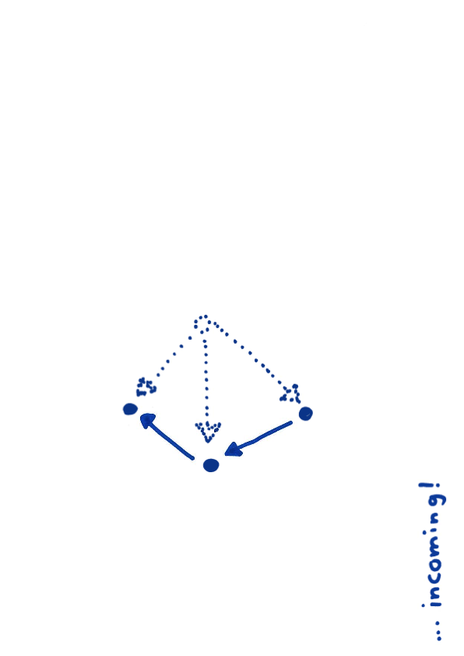
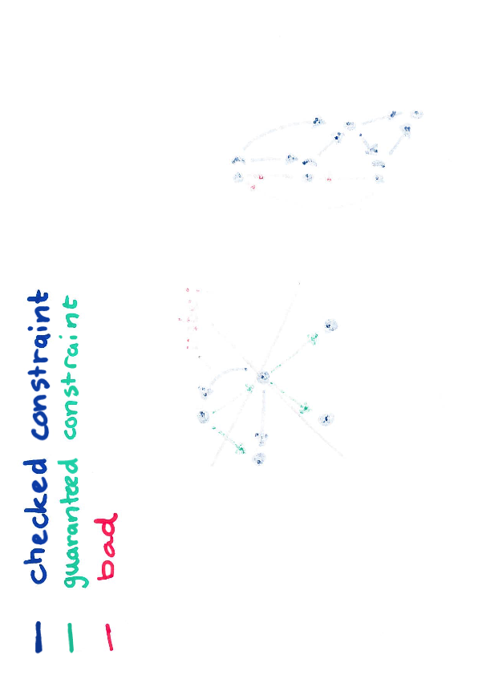
Let’s pretend the <-constraints are edges in a graph!

Slide 22
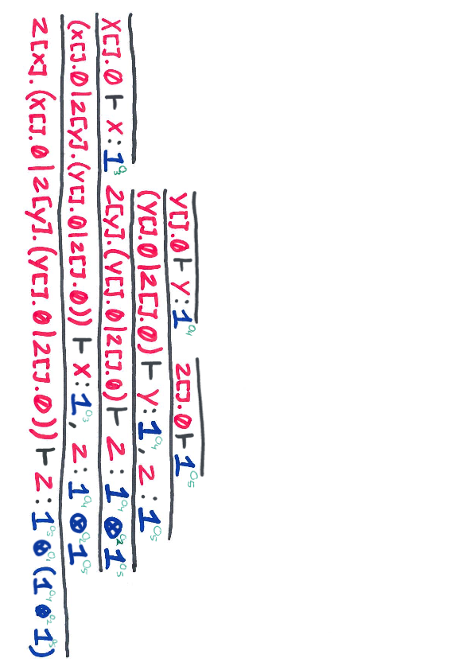
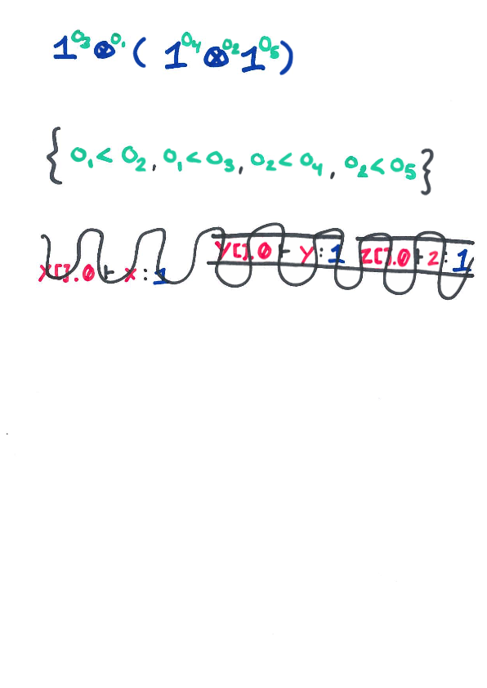

Slide 23

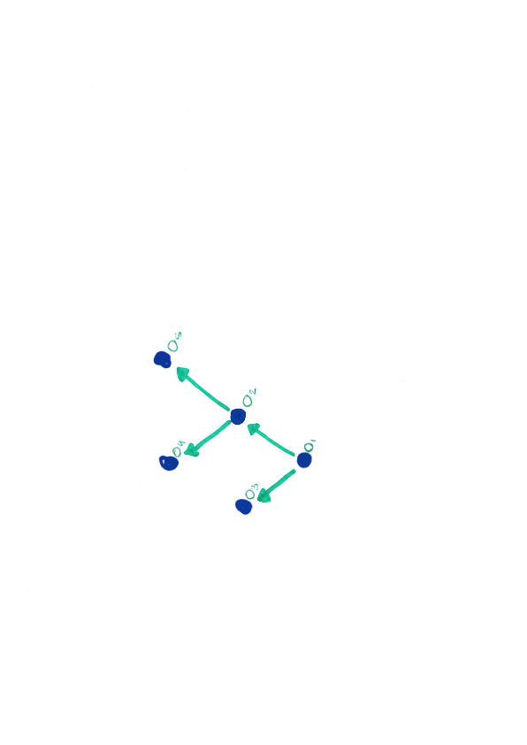

Slide 24
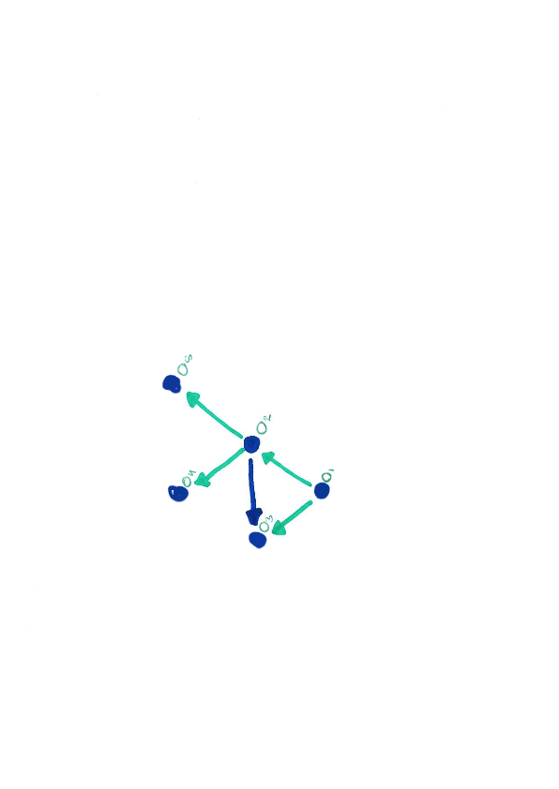
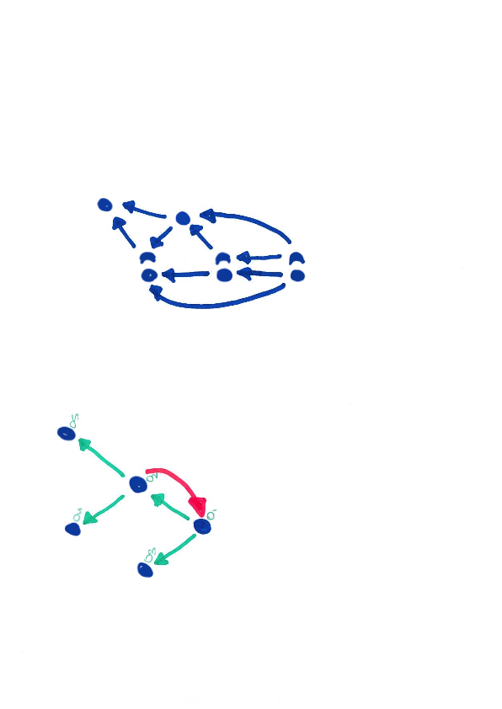

Slide 25
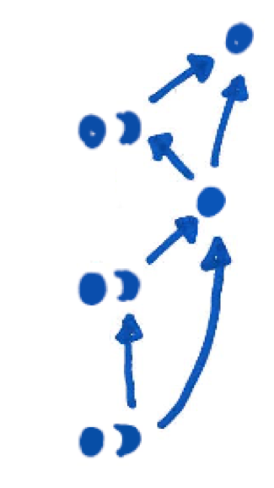
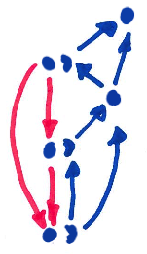

Slide 26
Conclusion!

Slide 27
Speculation Time!

Slide 28
What is the relation between global types and constraints?

Slide 30
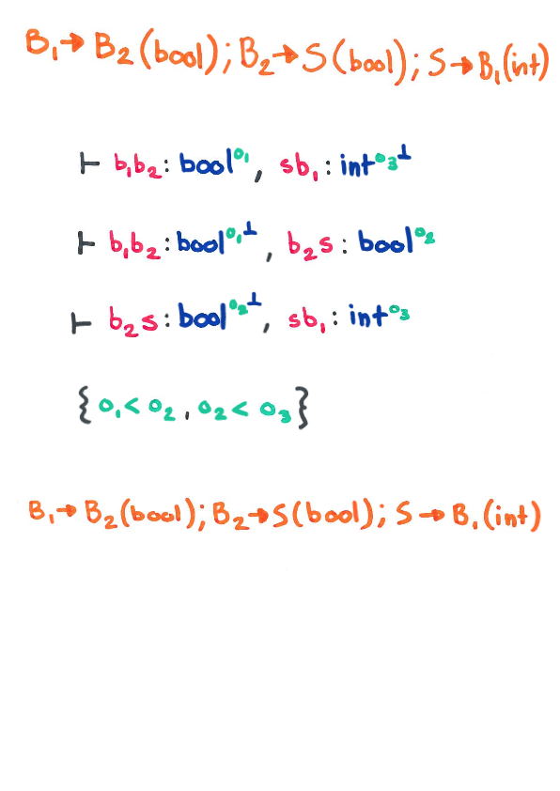

Slide 31
What about non-determinism?

Slide 34
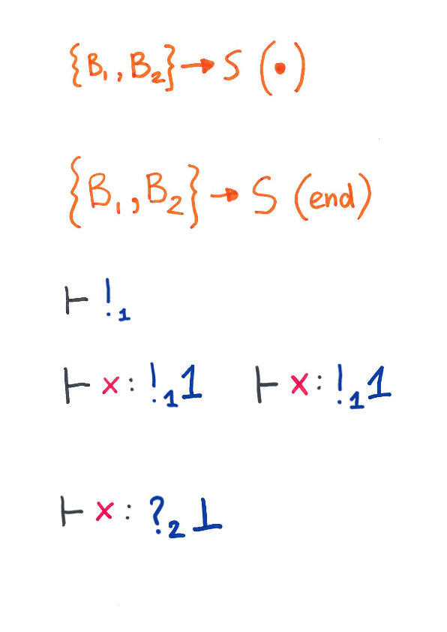

Slide 35
What about collapsing “!_{n}” and “?_{n}”?

Slide 36
Just grab a whiteboard, Wen,
it’s easier.

